Slide 1
Week 8+9 Presentation
Pauline Dang

Slide 2
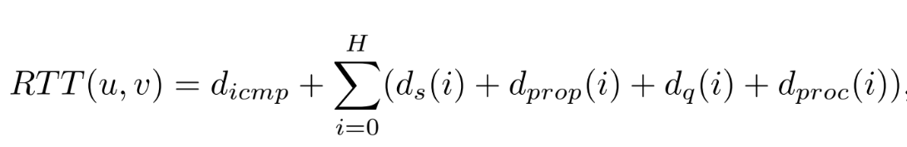
u: source
V: destination
RTT (u,v): Round trip time from u to v for a packet traversing a total of H hops in the round-trip path
d_{icmp}: The processing delay of ICMP messages in routers
ICMP is a protocol that devices in a network use to communicate problems with data transmission
d_{s}(i): delay induced by serialization
Serialization - the process of converting data object into byte stream, and saving the state of the object to be stored on a disk or transmitted across a network
d_{prop}(i): delay induced by propagation
The amount of it takes for the head of the signal to travel from the sender to the receiver
d_{proc}(i): delay induced by packet processing
The time if takes routers to process the packet header
d_{icmp}: a random variable that depends on router CPU utilization
d_{q}(i): a random variable that represents queuing size of network interfaces when packets arrive
Queuing delay is the most dominant factor in delay variation

Slide 3
Delay jitter is the absolute difference between the RTT of the current time episode and the previous one
In this paper, a time episode is defined to be 15 minutes

Slide 4
Congestion Inference tools
Change point detection - algorithm that splits RTT time series into candidate time intervals that might suffer congestion
KS-Test method - Combines detection of changes of RTT latency baseline with the Kolmogorov-Smirnov* test
Tests on the adjacent jitter samples
Jitter dispersion method - detects jitter dispersion increase that correlates with a baseline RTT increase as signal of congestion
Compares the mean values of the jitter dispersion signal
Bayesian Change Point Detection is chosen over others because it is the best at detecting boundaries of intervals with RTT latency measurements
Measured on data collected by Ark CAIDA and RIPE Atlas. We could also use this data but we would have to request it.

Slide 5
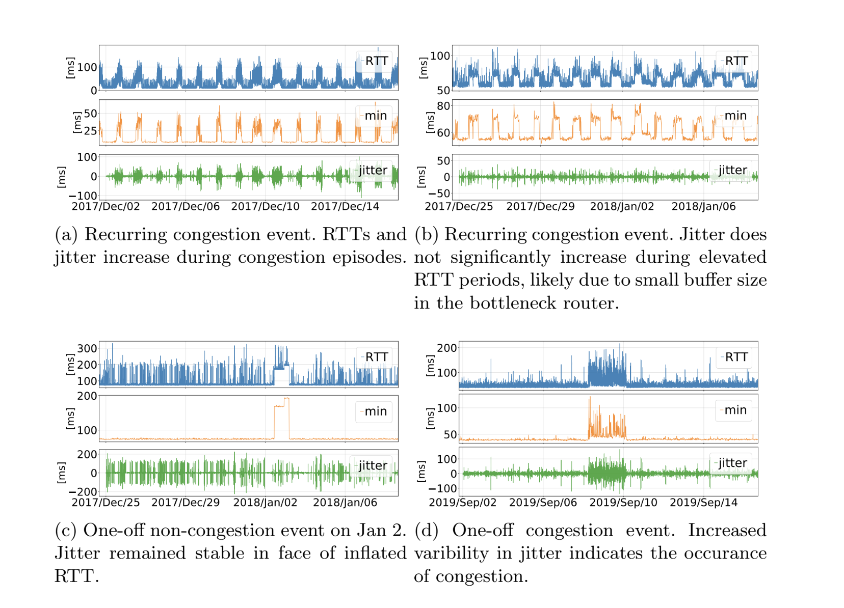
Raw data has 5 minute resolution.
Minimum function is taken every 15 minutes to filter noise.
Computing jitter using 15 minutes aggregated data

Slide 6
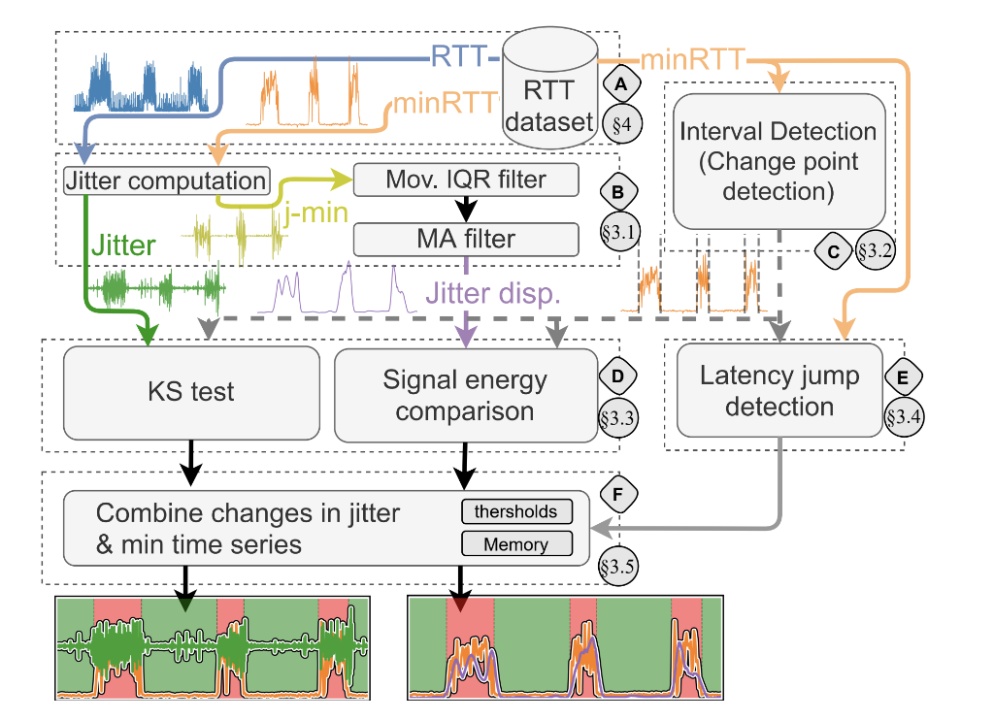

Slide 7
Congestion Inference Threshold
Increase confidence in Jitterbug
Compare the mean value of hte min RTT time series of consecutive intervals
Included a Jiter dispersion threshold which are the parameters 0.25 ms and 0.5 ms for jitter dispersion and baseline, respectively.
Allows us to reduce false positives and false negatives

Slide 8
Memory
Using theses processes, there rises an error of false positives in the change point detection process
During of period of prolonged congestion, the mean of increased latency may not change from one interval from the other, which the algorithm would detect no congestion when there is congestion. Therefore they added an element of memory that adds a rule that a period of congestion has not finished if in the following interval the mean value of the minimum RTT does not decrease
mean(minRT T(I2)) ≥ mean(minRT T(I1)).
I1 and I2 are two adjacent time intervals

Slide 9
Deep Learning to Predict Network Traffic
Adopting edge intelligence or edge- native AI framework design that uses AI models, communication networks, and cloud native edge computing design to predict traffic flow
Collect raw time series data and send it to the visibility center for storage and processing
Use the Kubeflow deployment to develop and train deep learning model
Kubeflow is a website that is a machine learning tool for kubenetes
Kubenetes is a software that auto manages, scales and maintain multi-container workloads in desired states
Train the model on collected data and predict statistical properties on model’s performance in terms of root-mean-square error(RMSE) and coefficient of determination (R^2)

Slide 10
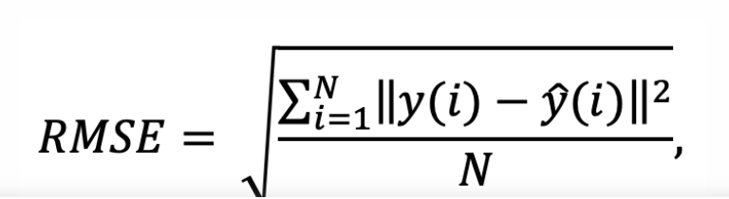
Root Mean Square Error
Shows how far predictions fall from measured true values using Euclidean distance
N: number of data points
y(i) is the measurement
y^(i): was the prediction

Slide 11
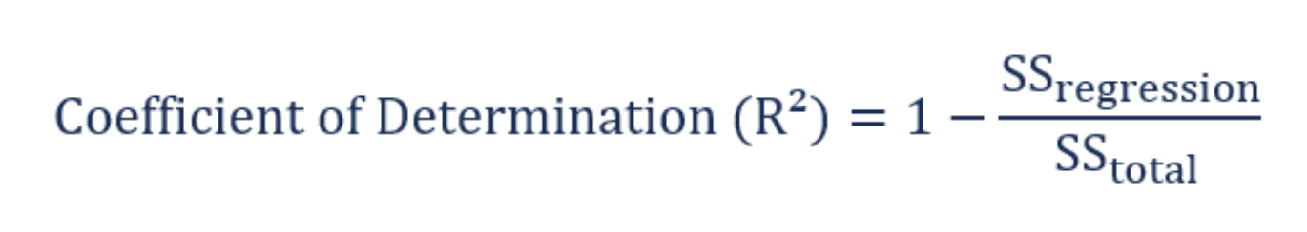
Coefficient of Determination
A statistical measure in a regression model that determines the proportion of variance
The determination of how well the regression model fits the observed data
SS _{regression}: The sum of squares due to regression
Measures how well the regression model represents the data that were used for modelling
SS _{Total}: The total sum of squares
Measures the variation of the observed data

Slide 12
Flaws with using Deep Learning
Only successful for 15-minute lookaheads
Makes is hard to understand what properties are being learned to make prediction decisions

